Slide 1
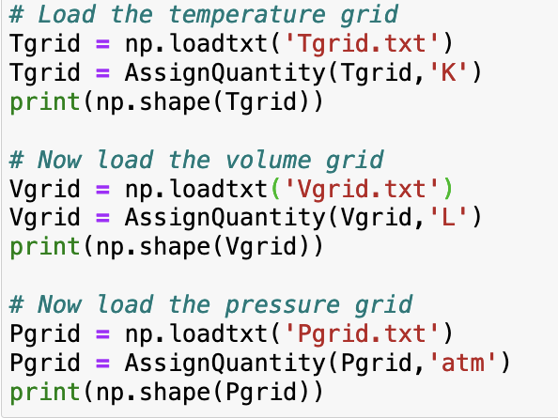

Today we’re going to talk about slices of thermodynamic functions, and their slopes
You may notice that there are some extra files in your folder
These commands load in that data

Slide 2
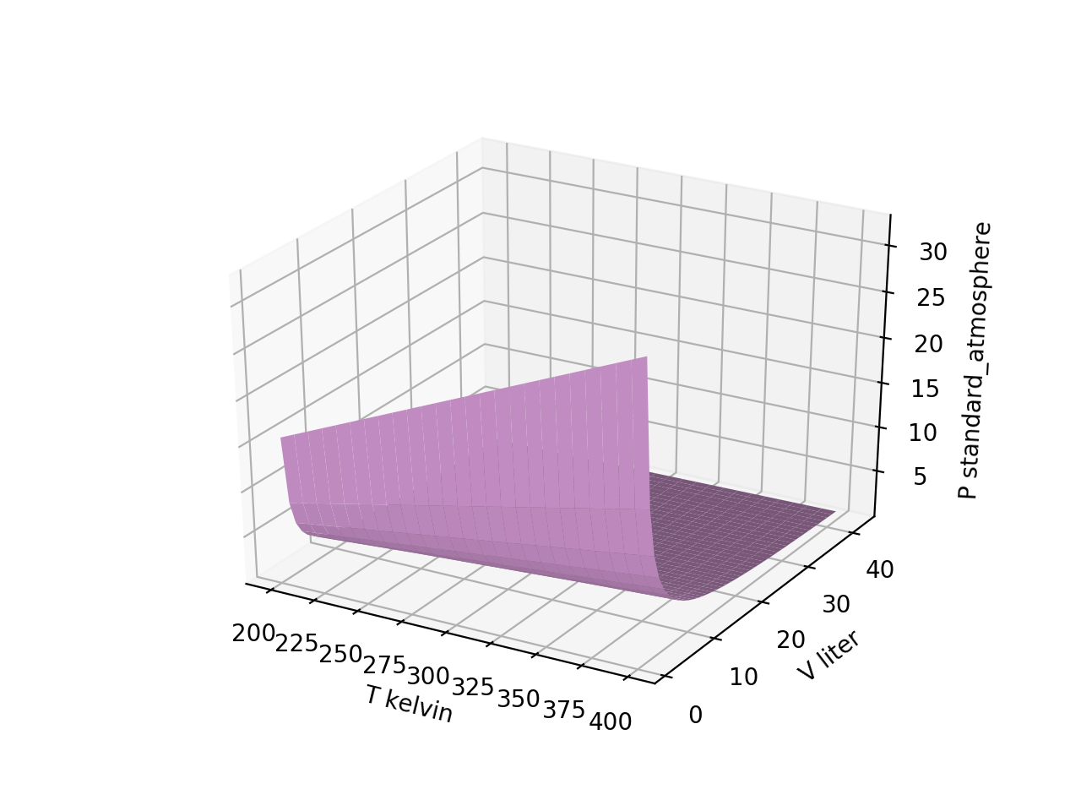
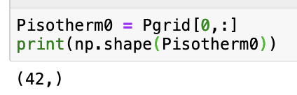
Slicing out the first isotherm of $P(T,V)$

Slide 3

Slicing out the last isotherm of $P(T,V)$

Slide 4
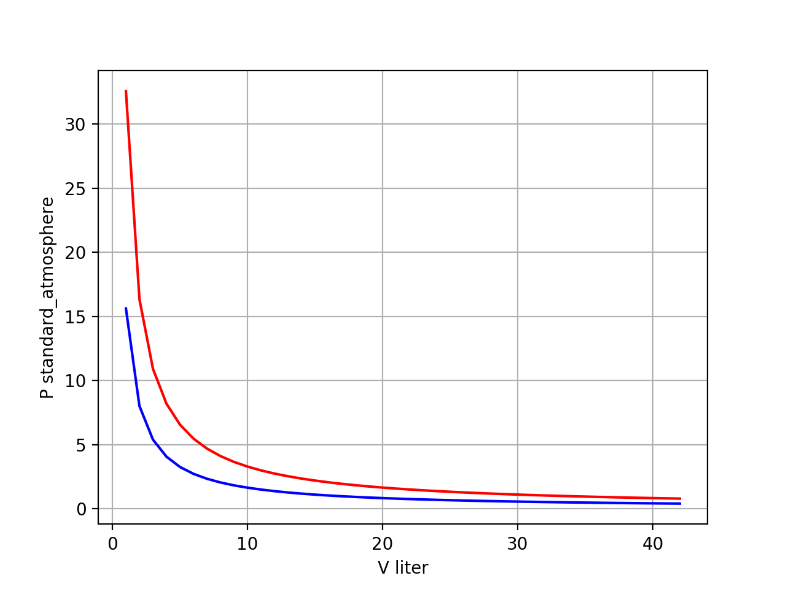
Plotting two isotherms of $P(T,V)$ together
“Boyle Isotherms”

Slide 5
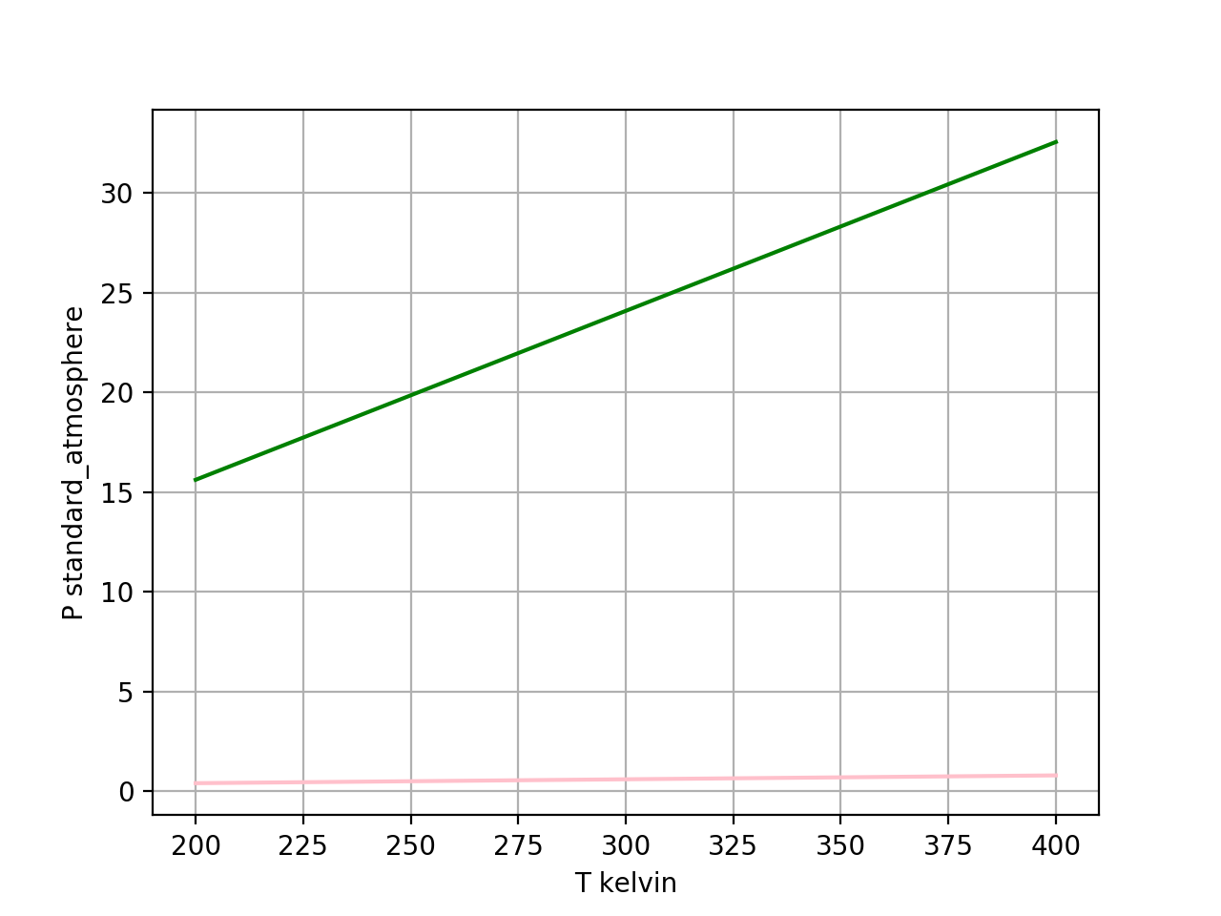
Plotting two isochores of $P(T,V)$ together
isochores

Slide 6
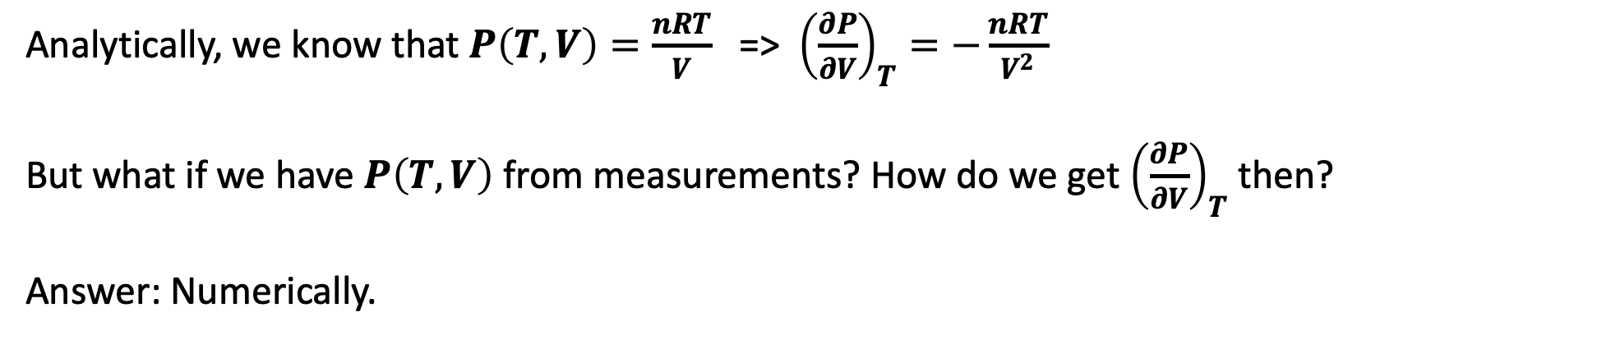
Taking derivatives
Analytically, we know that $P\left(T,V\right)=\frac{nRT}{V}$ => ${\left(\frac{∂P}{∂V}\right)}_{T}=−\frac{nRT}{V^{2}}$
But what if we have $P\left(T,V\right)$ from measurements? How do we get ${\left(\frac{∂P}{∂V}\right)}_{T}$ then?
Answer: Numerically.

Slide 7


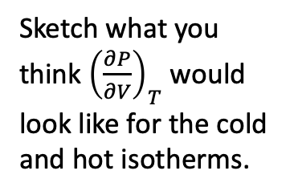
Numerical derivatives of Boyle isotherms
$P(V)$
Sketch what you think ${\left(\frac{∂P}{∂V}\right)}_{T}$ would look like for the cold and hot isotherms.
$${\left(\frac{∂P}{∂V}\right)}_{T}$$

Slide 8
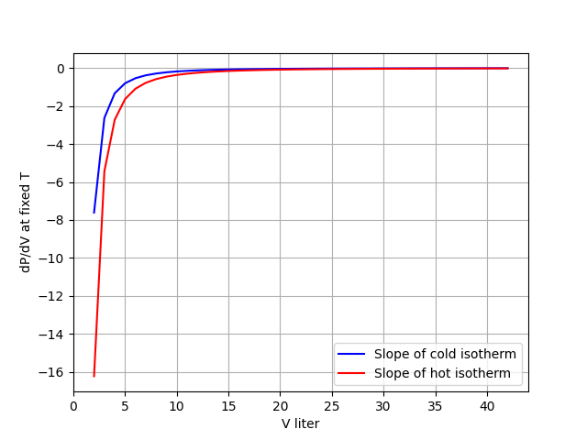
Numerical derivatives of Boyle isotherms
$P(V)$
$${\left(\frac{∂P}{∂V}\right)}_{T}$$

Slide 9
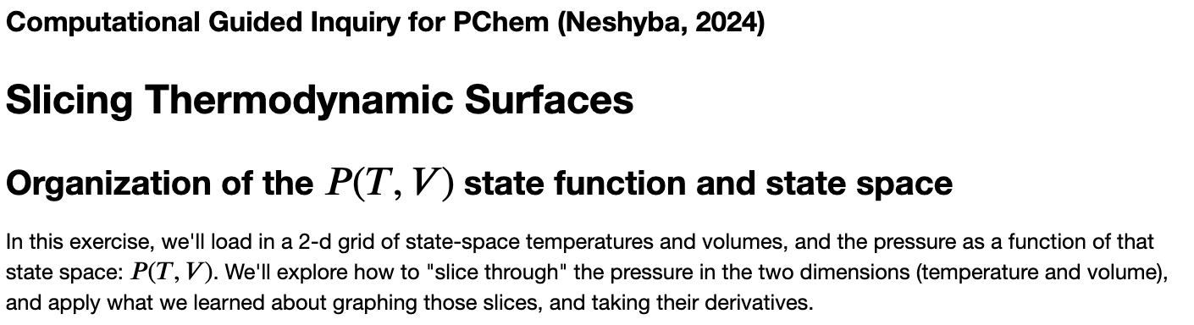
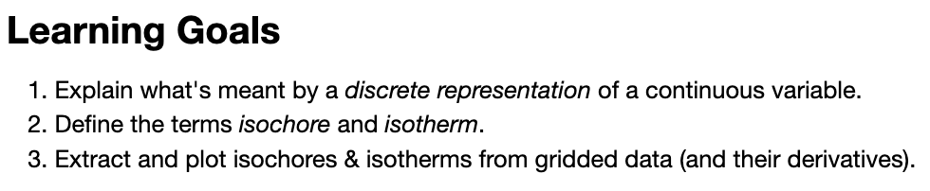
OK, let’s get started

